Slide 1
ENSE 470, Milestone 7
Tiger Vikings
Uys Kriek
Jay Denesik
Samuel Iregbu
Christian Anwanaodung
April 11th, 2018

Slide 2
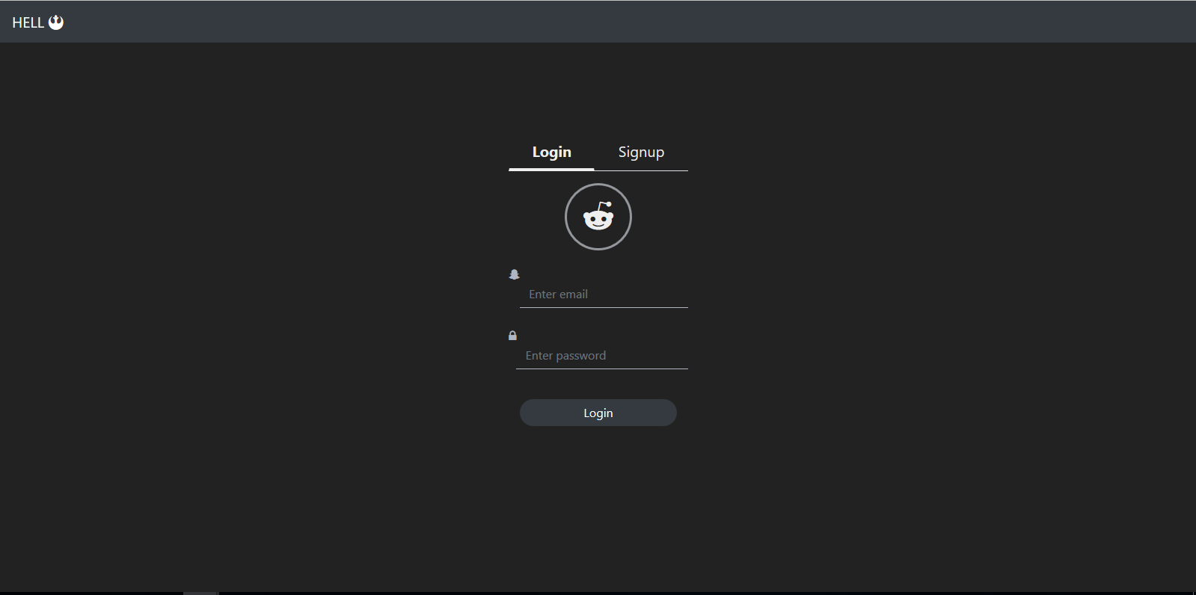
Screenshots of Timbits completed product

Slide 3
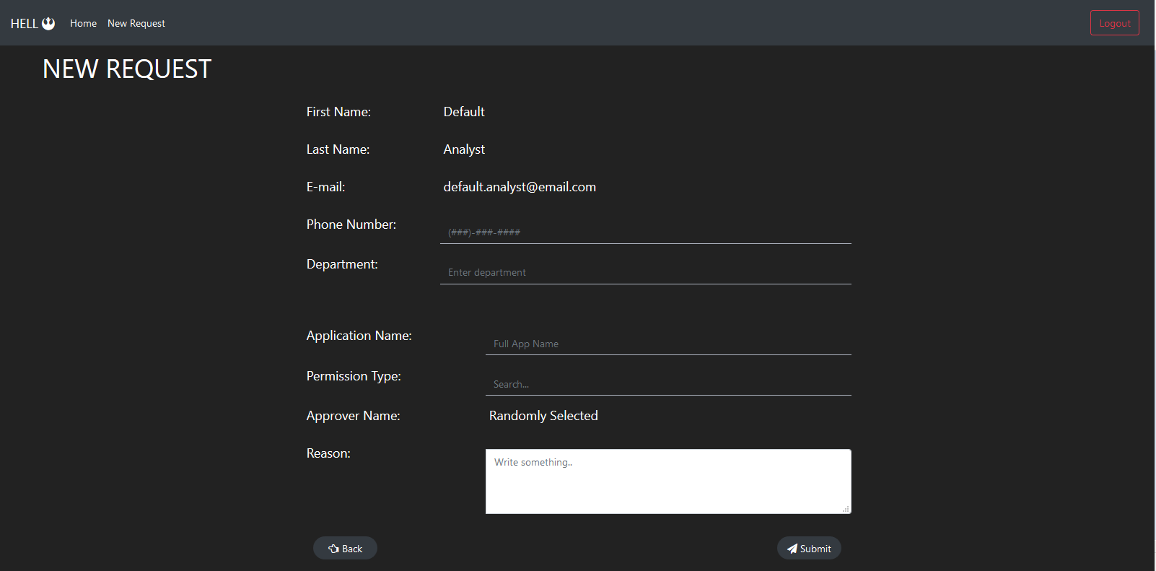
Screenshots of Timbits completed product

Slide 4
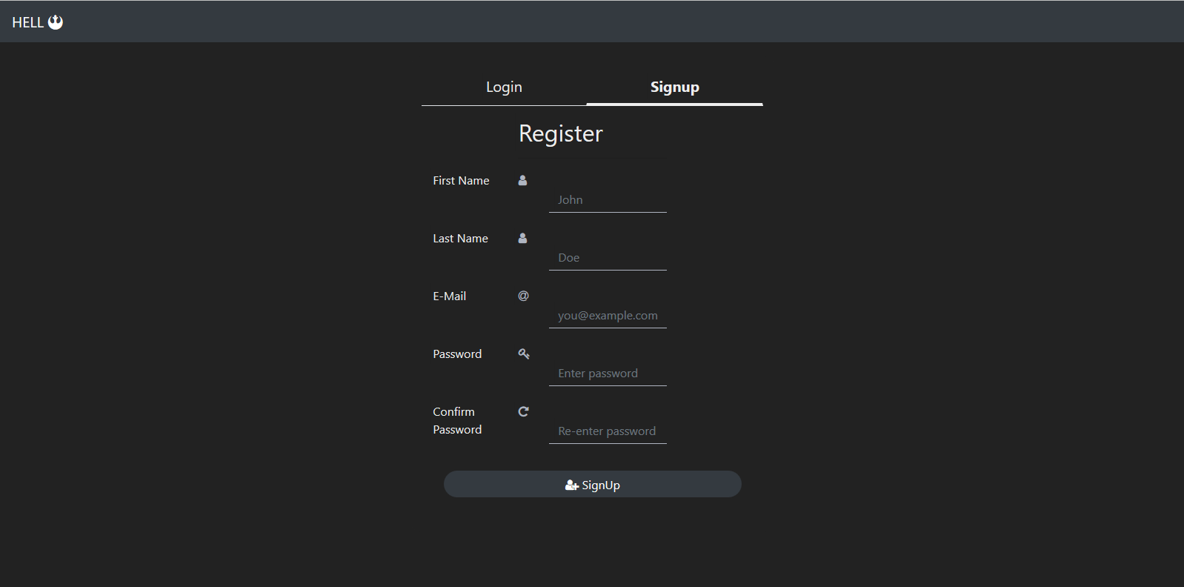
Screenshots of Timbits completed product

Slide 5
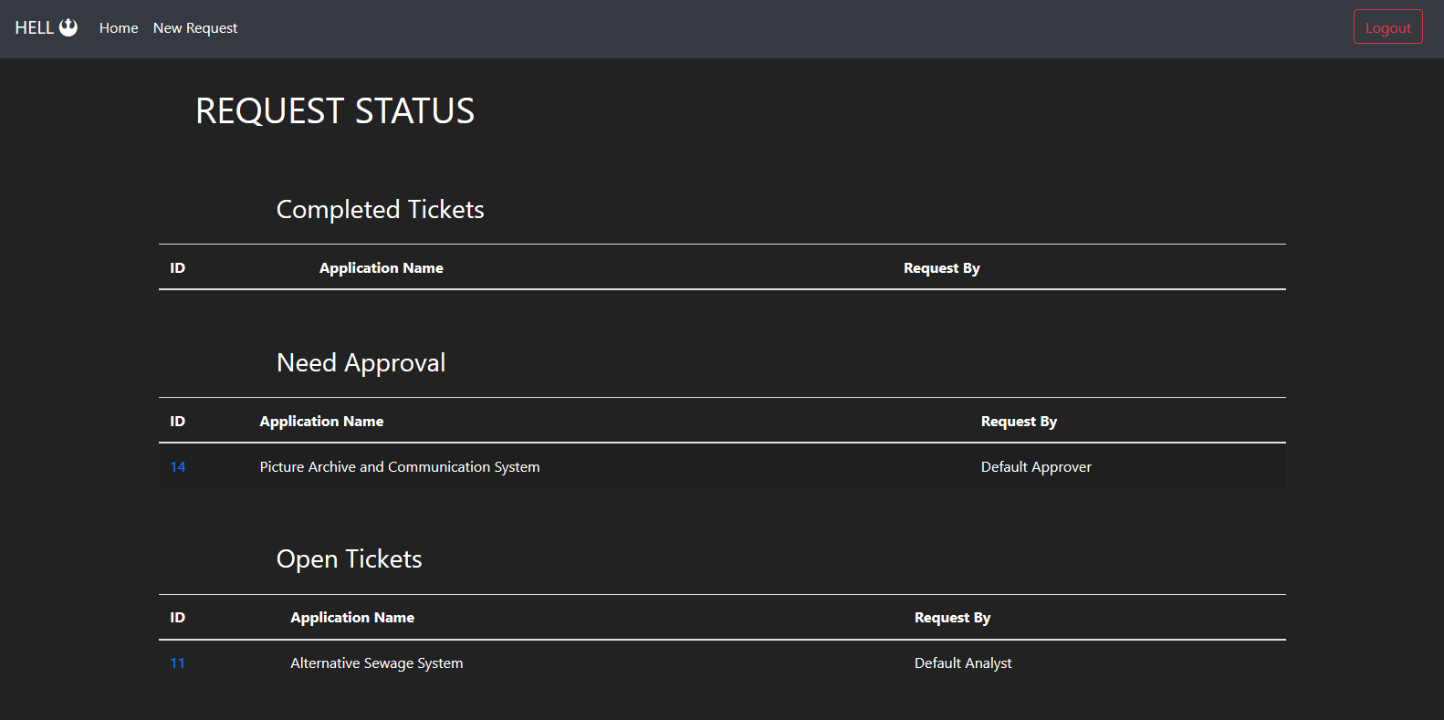
Screenshots of Timbits completed product

Slide 6
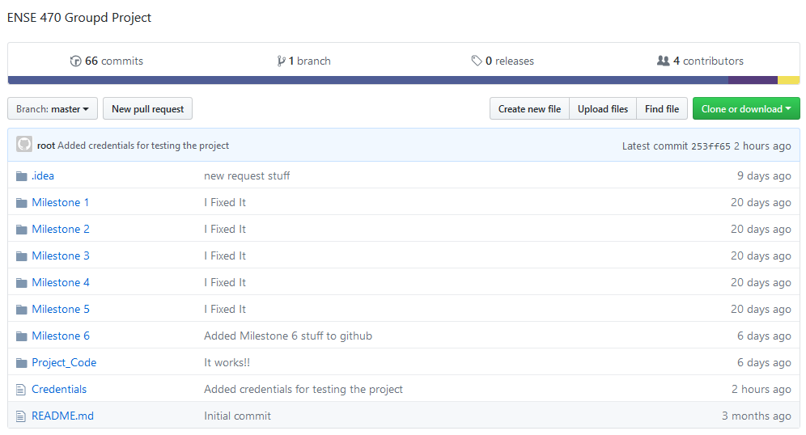
Team Github review

Slide 7
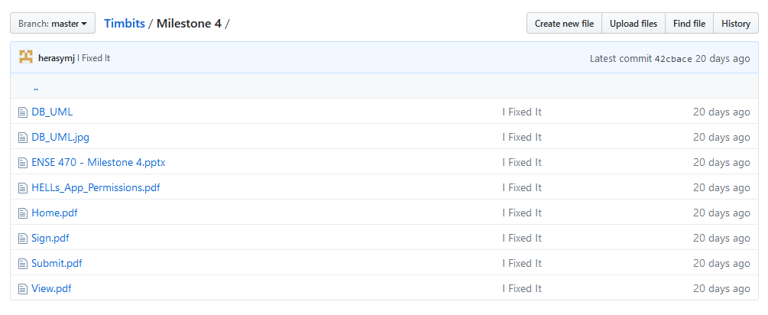
Team Github review

Slide 8
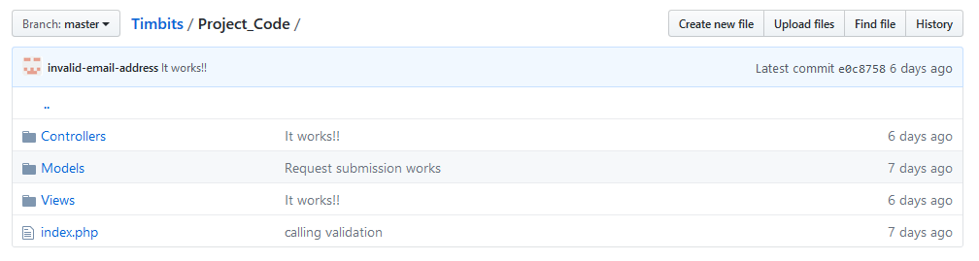
Team Github review

Slide 9
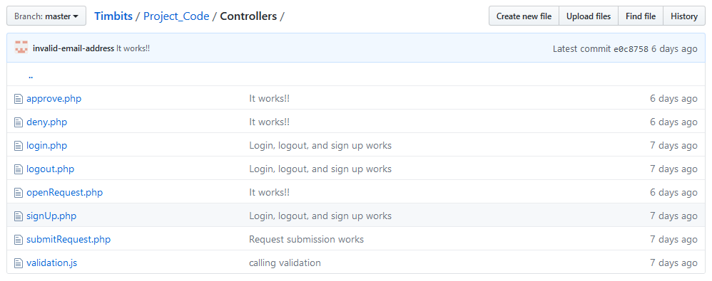
Team Github review

Slide 10

Team Github review

Slide 11
Refactor review
-Code is very readable
- Easy to follow
-Most of the ATDD’s passed
- Some error notification ATDD’s failed

Slide 12
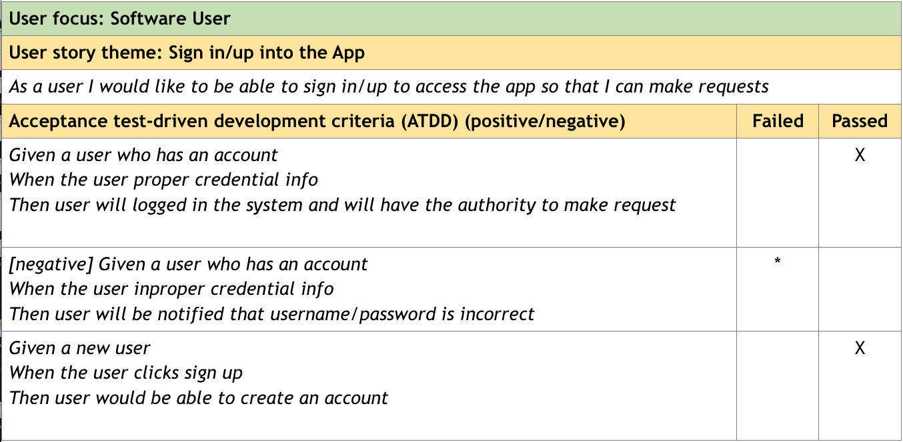

Slide 13
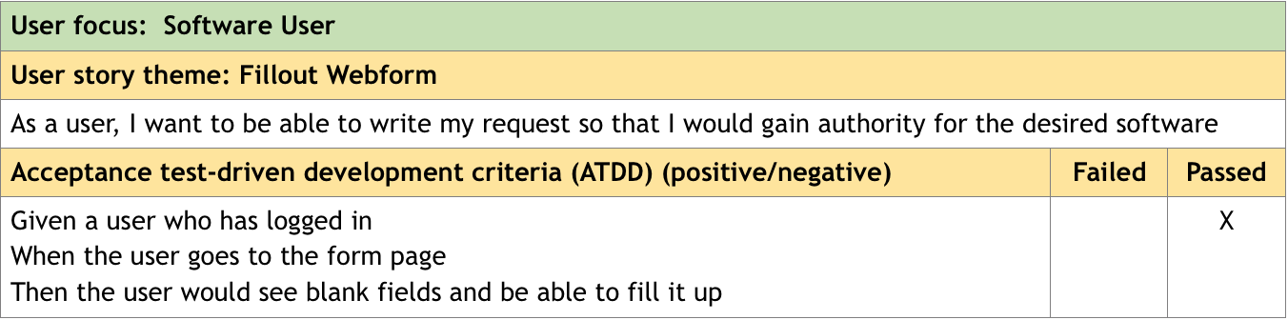

Slide 14
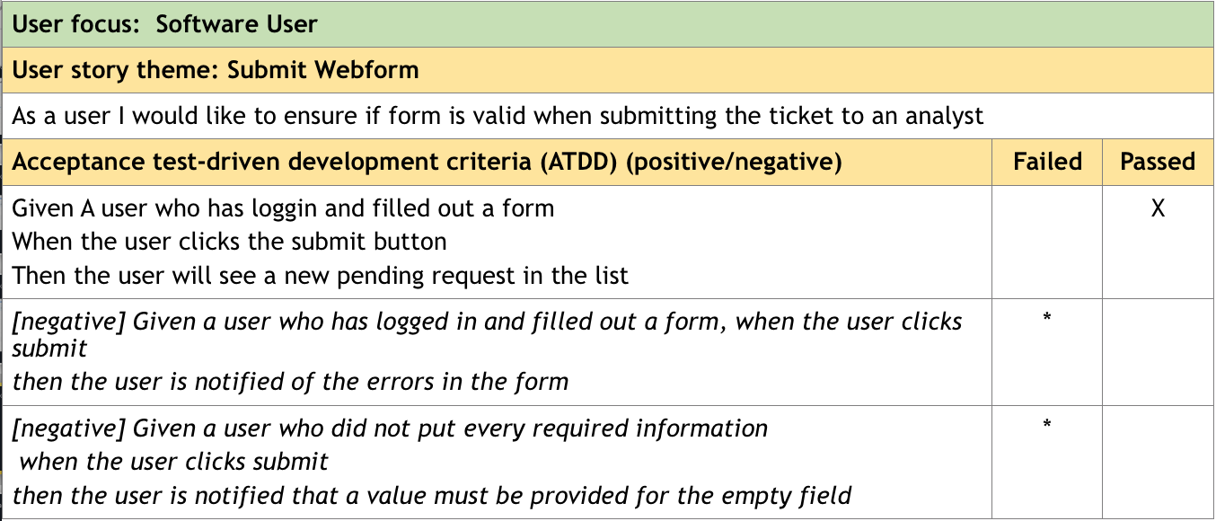

Slide 15
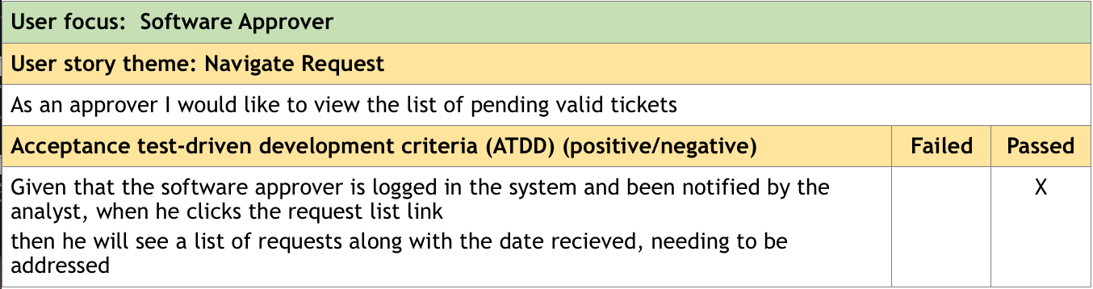
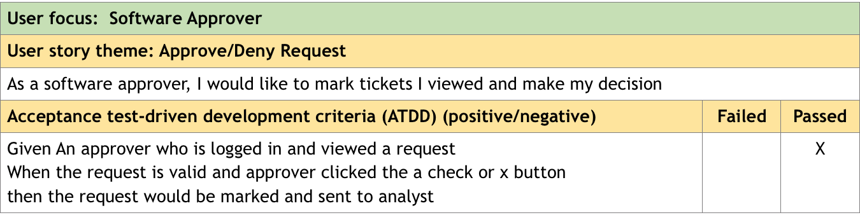

Slide 16
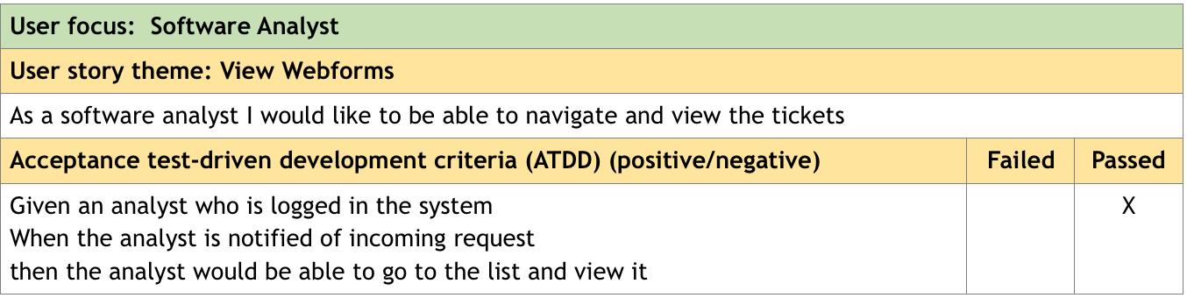
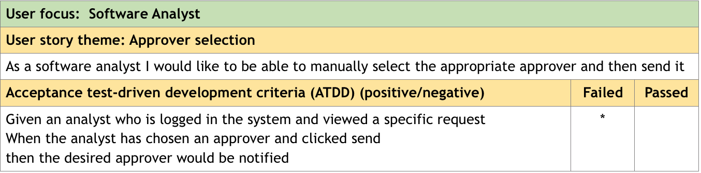

Slide 17
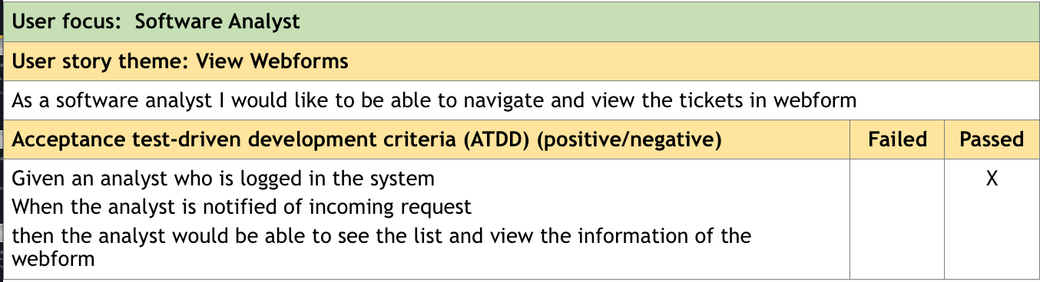

Slide 18
ATDD REVIEW
Their ATDD’s were relative easy to find on GitHub
From the ATDD tests provided from Milestone 5 only 4 of them failed out of 12

Slide 19
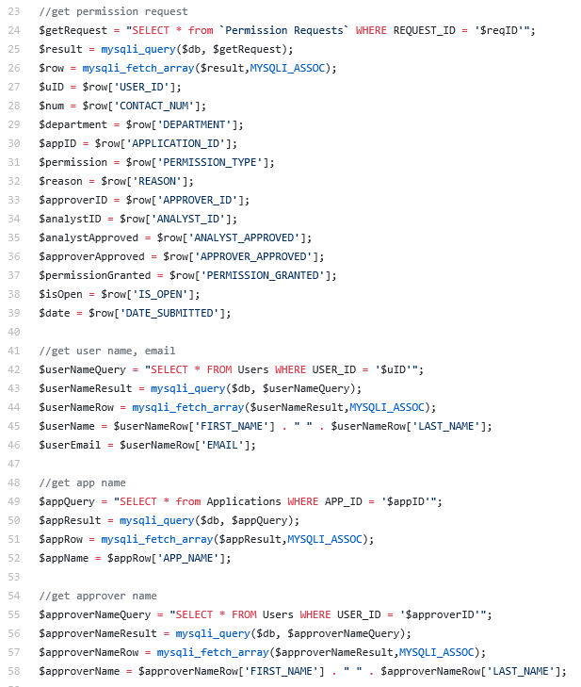
Refactor review
Code smells
Long method
-A method contains too many lines of code

Slide 20
Refactor review
Code smells
-Long Parameter List
- Too many parameters being passed into a method
Example:

Slide 21
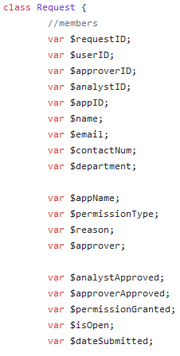
Refactor review
Code smells
-Data class
- Request class contains only fields and constructor
- Data is not operated on within the Request class

Slide 22
Refactor review
Code smells
Documentation: Documentation plays a vital role when it comes to development. One should always have comments that explains the logic of an entire program or the different code segments in the program.

Slide 23
Refactor review
Code smells
Long Method: This can be made better by using extract methods.
Example: function getUserNameAndEmail()
function getAppName()
function getApproverName()

Slide 24
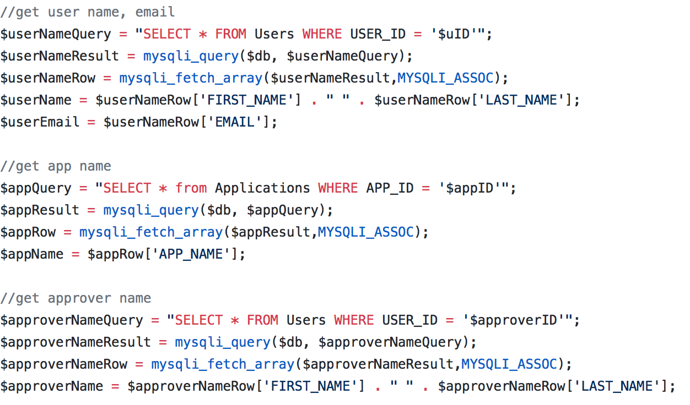

Slide 25
Other mentions
Some of the functionalities only worked on google chrome
No error messages were displayed if a mistake was made in the forms
They had some security checks which were really nice
However their design and view of the project was really nice

Slide 26
Design pattern discussion (High-level focus)
State design pattern
-Depending on which person you sign in as, defines what you can and cannot do
- IE. Approvers cannot request software, whereas users can

Slide 27
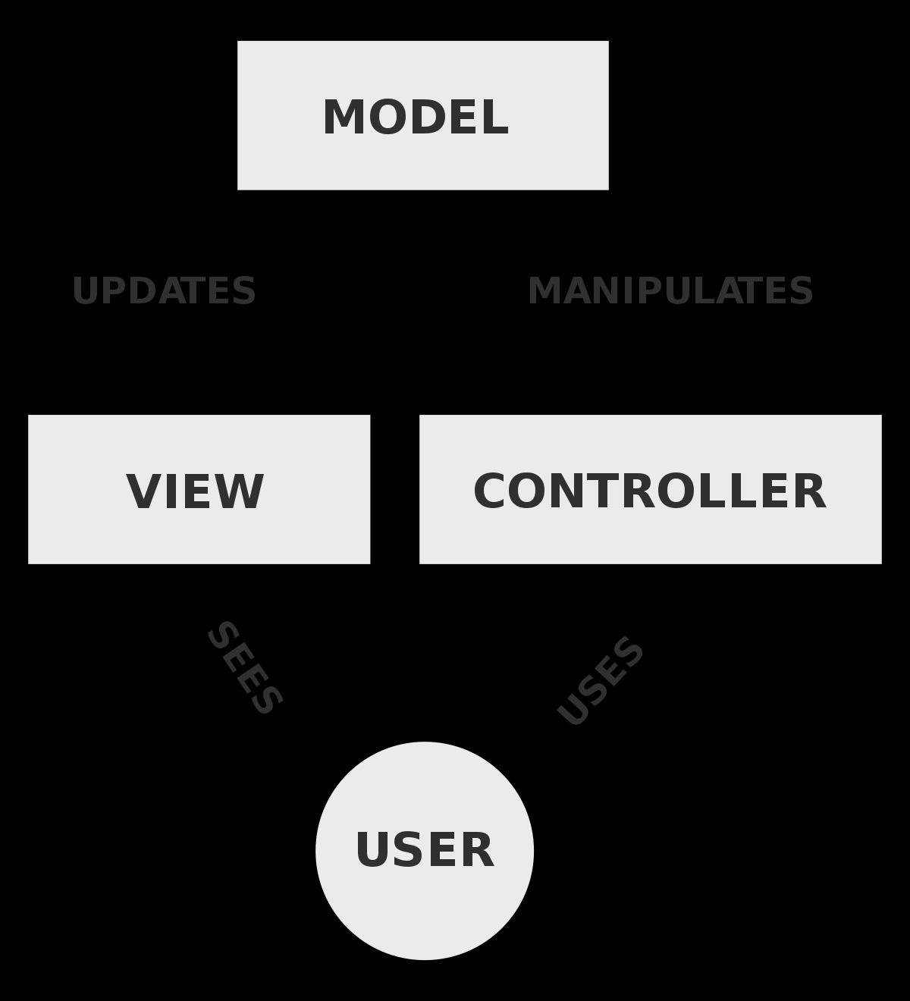
Design pattern discussion (High-level focus)
Main design pattern used was Model-View-Controller
-Appropriate for this project

Slide 28
Group reflection
How did you feel about this milestone? What did you like about it? What did you dislike?
-Understanding code could be difficult if not familiar with language
-What did you learn about yourself as you collaborated and worked through this milestone?
-We learned how to laugh and enjoy ourselves while working
-How will you use what you have learned going forward?
- Refactoring guru website was very useful. Taught us skills that will come in handy in our future careers
-What “stuff & things” related to this milestone would you want help with?
- Nothing it was good.

